Slide 1

Machine Learning clustering
SENTHILKUMAR T H

Slide 2
Clustering
Clustering is an unsupervised machine learning technique used to group similar data points into clusters or "groups,“ where data points within each group are more similar to each other than to those in other groups.

Slide 3
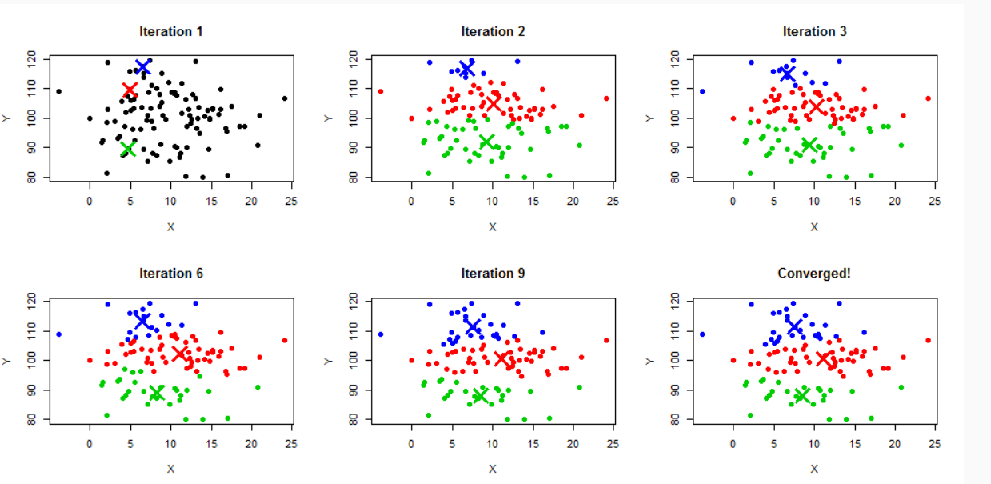
K-Means Clustering
K-Means is one of the most popular and widely used clustering algorithms in machine learning. It is an unsupervised learning algorithm that partitions data into K clusters based on feature similarity. The goal is to minimize the variance (or within-cluster sum of squares) by grouping similar data points together.

Slide 4
Advantages of K-means Clustering:
Simple and Easy to Understand:
Intuitive algorithm: K-means is relatively easy to understand and implement. The concept of centroids (cluster centers) and assigning points to the nearest cluster is straightforward.
Scalability: K-means can handle large datasets efficiently. Its time complexity is 𝑂(𝑛⋅𝑘⋅𝑡) O(n⋅k⋅t),
where:
n is the number of points,
k is the number of clusters,
t is the number of iterations.
For large values of k and t, the algorithm may take time, but it’s generally fast enough for medium-sized datasets.
Disadvantages of K-means Clustering:
Requires Predefined Number of Clusters (k)

Slide 5
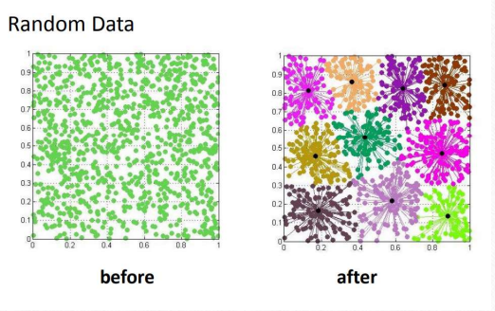
Affinity Propagation Clustering
Affinity Propagation creates clusters by sending messages between pairs of samples until convergence.
A dataset is then described using a small number of exemplars, which are identified as those most representative of other samples.
The messages sent between pairs represent the suitability for one sample to be the exemplar of the other, which is updated in response to the values from other pairs.

Slide 6
Affinity Propagation works based on similarities between data points
In Affinity Propagation there are two kinds of message exchanged between data points, they are Responsibility and Availability
Considers all data points as potential cluster center
Identifies a set of cluster center that represents the dataset
Takes as input a collection of similarities matrix
Deterministic which is its clustering results do not depend on initialization
Advantage:
Has better performance and lower clustering error
Disadvantage:
It is quite slow and memory-heavy, making it difficult to scale to larger datasets. We do not have any direct control on the number of clusters but in some applications, we need a specific number of clusters.

Slide 7
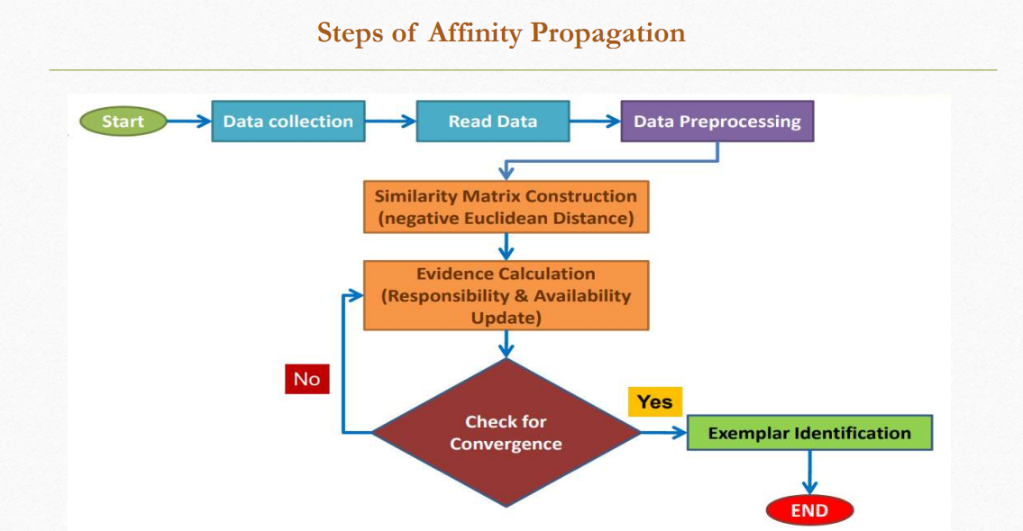

Slide 8
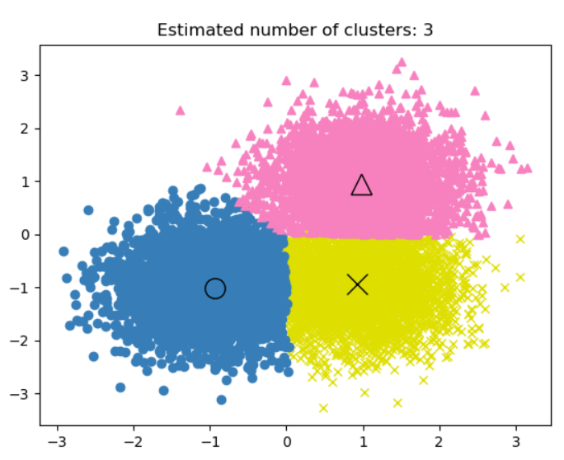
Mean Shift Clustering
Mean-shift algorithm basically assigns the datapoints to the clusters iteratively by shifting points towards the highest density of datapoints i.e. cluster centroid.
The difference between K-Means algorithm and Mean-Shift is that later one does not need to specify the number of clusters in advance because the number of clusters will be determined by the algorithm w.r.t data

Slide 9
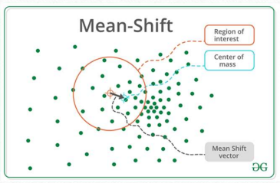
Working of Mean-Shift Algorithm
We can understand the working of Mean-Shift clustering algorithm with the help of following steps
Step 1 − First, start with the data points assigned to a cluster of their own.
Step 2 − Next, this algorithm will compute the centroids.
Step 3 − In this step, location of new centroids will be updated.
Step 4 − Now, the process will be iterated and moved to the higher density region.
Step 5 − At last, it will be stopped once the centroids reach at position from where it cannot move further.

Slide 10
Advantages and Disadvantages of Mean Shift Clustering
Advantages
It does not need to make any model assumption as like in K-means or Gaussian mixture.
It can also model the complex clusters which have nonconvex shape.
It only needs one parameter named bandwidth which automatically determines the number of clusters.
There is no issue of local minima as like in K-means.
No problem generated from outliers.
Disadvantages
Mean-shift algorithm does not work well in case of high dimension, where number of clusters changes abruptly.
We do not have any direct control on the number of clusters but in some applications, we need a specific number of clusters.
It cannot differentiate between meaningful and meaningless modes

Slide 11
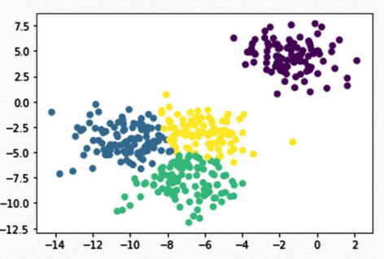
Spectral Clustering
In spectral clustering, data points are treated as nodes of a graph. Thus, spectral clustering is a graph partitioning problem.
The nodes are then mapped to a low-dimensional space that can be easily segregated to form clusters. No assumption is made about the shape/form of the clusters.
The goal of spectral clustering is to cluster data that is connected but not necessarily compact or clustered within convex boundaries.

Slide 12
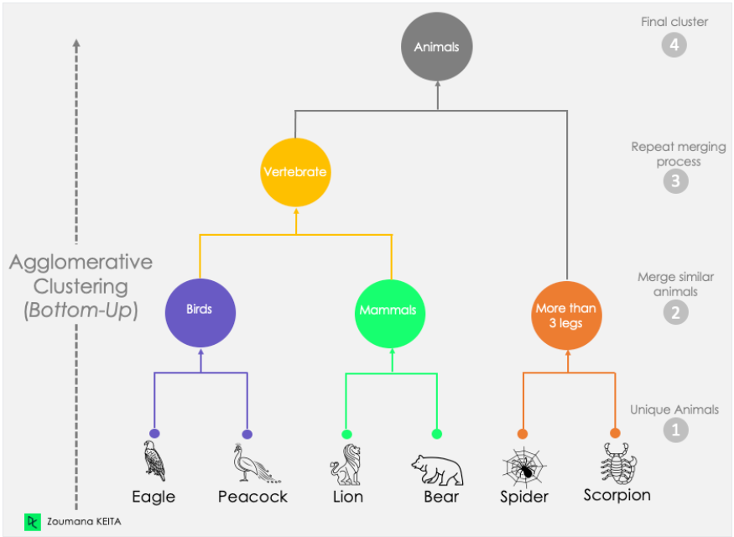
Agglomerative Clustering
Agglomerative Clustering is a type of hierarchical clustering algorithm. It is a bottom-up approach, meaning it starts by treating each data point as its own cluster and progressively merges the closest pairs of clusters. This process continues until a stopping condition is met, such as when all points are in a single cluster or a predefined number of clusters is achieved.

Slide 13
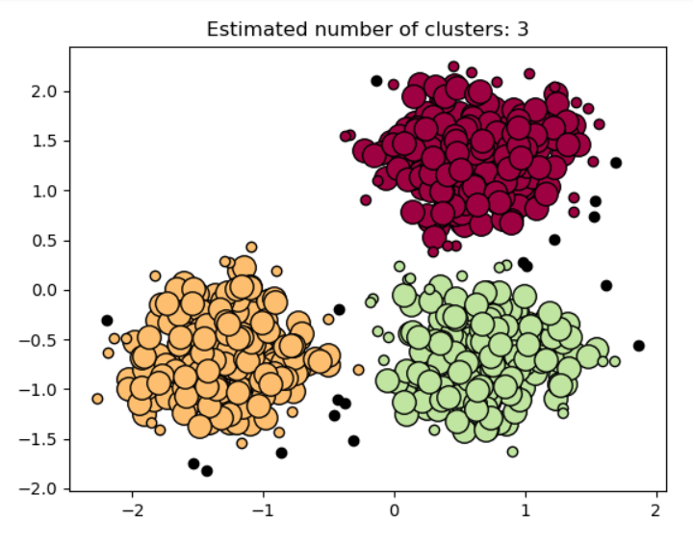
DBSCAN
DBSCAN (Density-Based Spatial Clustering of Applications with Noise) is a popular density-based clustering algorithm. It is particularly effective at discovering clusters of arbitrary shape and size in spatial data, especially when the data contains noise (outliers). Unlike methods like K-means, DBSCAN does not require the user to specify the number of clusters in advance, making it highly flexible and automatic in terms of cluster detection.

Slide 14
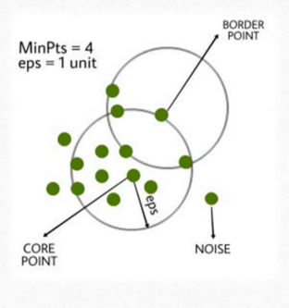
DBSCAN algorithm can be abstracted in the following steps:
1. Find all the neighbor points within eps and identify the core points or visited with more than MinPts neighbors.
eps: It defines the neighborhood around a data point i.e. if the distance between two points is lower or equal to ‘eps’ then they are considered neighbors. If the eps value is chosen too small then large part of the data will be considered as outliers. If it is chosen very large then the clusters will merge and the majority of the data points will be in the same clusters. One way to find the eps value is based on the k-distance graph.
MinPts: Minimum number of neighbors (data points) within eps radius. Larger the dataset, the larger value of MinPts must be chosen. As a general rule, the minimum MinPts can be derived from the number of dimensions D in the dataset as, MinPts >= D+1. The minimum value of MinPts must be chosen at least 3.
2. For each core point if it is not already assigned to a cluster, create a new cluster.
3. Find recursively all its density connected points and assign them to the same cluster as the core point.
4. Iterate through the remaining unvisited points in the dataset. Those points that do not belong to any cluster are noise.

Slide 15
Advantages and Disadvantages of DBSCAN Clustering
Advantages
DBSCAN is great at separating high-density clusters from low-density clusters,
DBSCAN can be used to detect clusters that are oddly or irregularly shaped, such as clusters that are ring-shaped.
DBSCAN is used to handle clusters of multiple sizes and structures and is not powerfully influenced by noise or outliers.
Disadvantages
DBSCAN struggles with clusters of similar density.
Struggles with high dimensionality data. If given data with too many dimensions, DBSCAN suffers.

Slide 16
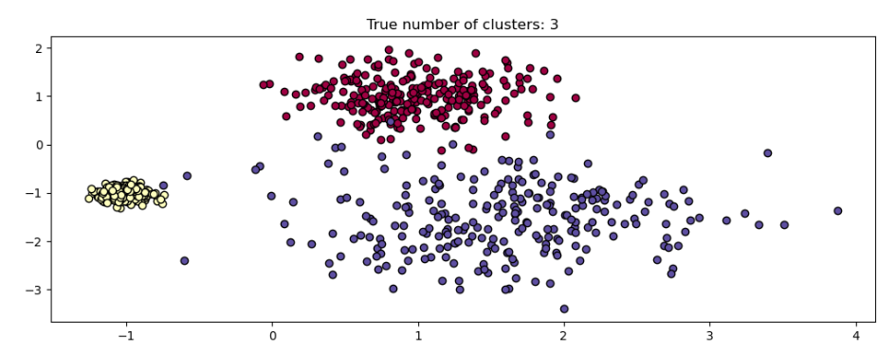
HDBSCAN
HDBSCAN (Hierarchical DBSCAN) is an extension of DBSCAN that aims to improve clustering performance, especially in cases with clusters of varying density. While DBSCAN is effective at detecting clusters in dense regions, it struggles when there are clusters with significantly different densities. HDBSCAN builds upon the core principles of DBSCAN but introduces hierarchical clustering and density-based approaches to address these challenges.

Slide 17
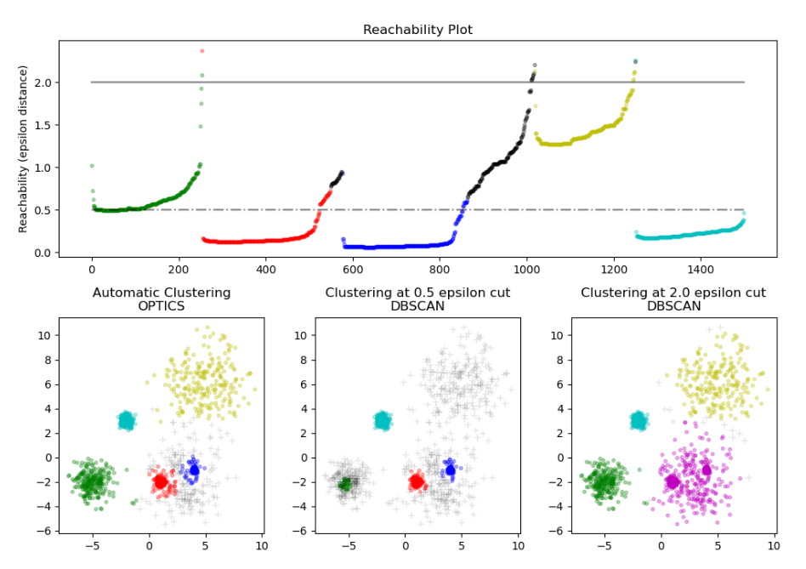
OPTICS
OPTICS (Ordering Points To Identify the Clustering Structure) is a clustering algorithm that is similar to DBSCAN in that it is density-based, but it has a key advantage: it can identify clusters of varying densities and does not require the user to predefine the number of clusters or the radius parameter (ε) as in DBSCAN. OPTICS is particularly useful in situations where the density of the clusters is not uniform, which is a limitation for algorithms like DBSCAN and K-means.
OPTICS provides a more flexible solution by producing a reachability plot instead of an explicit clustering of the data. This reachability plot helps in identifying clusters of varying density by ordering points based on their reachability distance.

Slide 18
Advantage and disadvantage of optics
Advantage
OPTICS clustering doesn't require a predefined number of clusters in advance
Clusters can be of any shape, including non-spherical ones
Disadvantages
It fails if there are no density drops between clusters
It is also sensitive to parameters that define density (radius and the minimum number of points) and proper parameter settings require domain knowledge.

Slide 19
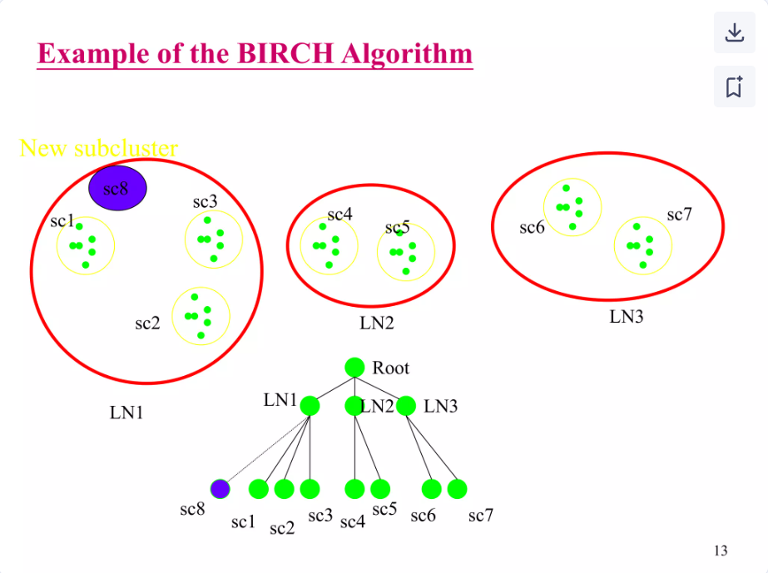
Birch Clustering
BIRCH is a hierarchical clustering algorithm designed to handle large datasets efficiently by combining the advantages of both hierarchical clustering and K-means. It is especially effective when dealing with datasets that cannot be processed by traditional clustering algorithms (like K-means) due to their high computational cost.

